Slide 1
NPTEL
Video Course on Machine Learning
Professor Carl Gustaf Jansson, KTH
Week 6 Machine learning based on
Artificial Neural Networks
Video 6.1 Fundamentals of Part 2
Artificial Neural Networks

Slide 2
Learning mechanisms in Symbolic and
Sub-symbolic Systems
Symbolic systems are exemplified by representations such as Logical, Functional and Object oriented representations and specific representation schemes like Production Rules, Decision Trees, Bayesian Networks and Semantic Networks.
Subsymbolic systems are exemplified by ANNs and Genetic Algorithms.
A few important differences (and similarities) with respect to Learning
Learning mechanisms are typically add-ons to the normally static kernels of symbolic systems. In contrast Learning mechanisms are typically embedded in the core of sub-symbolic systems.
As a consequence problem solving and learning are much more tightly integrated in sub-symbolic systems than in symbolic.
What is learned and how is normally very concrete and explicit in symbolic systems, while in sub-symbolic systems the process as well as the result is very much the opposite in sub-symbolic systems
To learn new structures in Symbolic Systems means to literally reshape and extend current structures. In contrast sub-symbolic systems pre-allocate large
and initially not used structures that are incrementally taken into use as
learning proceeds. The trick is to convert structure learning into parameter learning.
5. For parameter learning the differences are less articulated.

Slide 3
Learning in Artificial Neural Networks
Learning in an artificial neural network is normally accomplished through an adaptive procedure, known as a learning rule or algorithm whereby the weights and biases of the network are incrementally adjusted.
Potentially hyper parameters may also be learned.
For several reasons, the learning process is best viewed as an optimization process. More precisely, the learning process can be viewed as search in a multi-dimensional parameter (weight) space or as a tentative solution which gradually optimizes a pre-specified objective function.
An objective function is a function that maps an event onto a real number intuitively representing some "cost“ associated with the event. Synonymously an objective function can be named a cost function or loss function. The cost should of course be minimized.
In an inverse sense an objective function can be called a reward function or synonymously a profit function, a utility function or a fitness function.
In this case the objective function it is to be maximized.

Slide 4
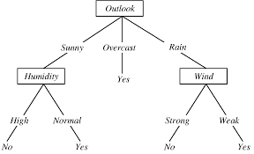
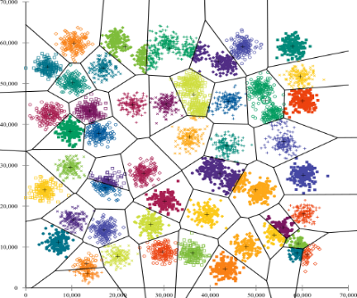
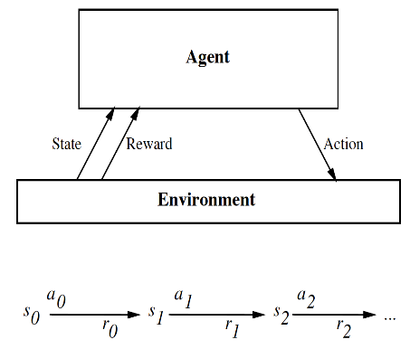
ANNs can be used for supervised,
reinforced and un-supervised learning tasks.
In supervised learning each input pattern/signal received from the environment is associated with a specific desired target pattern. Usually, the weights are synthesized gradually, and at each step of the learning process they are updated so that the error between the network's output and a corresponding desired target is reduced.
Unsupervised learning involves the clustering of (or the detection of similarities among) unlabeled patterns of a given training set. Here, the weights and the outputs of the network are usually expected to converge to representations which capture the statistical regularities of the input data.
Reinforcement learning involves updating the network's weights in response to an evaluators reward. Reinforcement learning rules may be viewed as stochastic search mechanisms that attempt to maximize the probability of positive external reward for a given training set.

Slide 5
Examples of Learning Rules
Hebbian learning rule - based on the Hebbian principle of concurrent activation as a basis for synaptic plasticity
T
Wi j+1 = W i j +α * Yj*Xi j, α = learning rate parameter. Yj = Xi j Wi j, i = input, j =iteration
------------------------------------------------------------------------------------------------------------------------------------------------------
Perceptron learning rule - a simpler version of the delta rule for ONE neuron=perceptron
T
Wi j+1= Wi j+ α * (Tj-Yj)* Xi j, α = learning rate parameter. Yj = Xi j Wi j, i = input, j =iteration, T = target
Delta learning rule - for single layer networks - based on gradient descent and means square error estimates
W j i =Wj i+ α *(Tj-Yj) G´(Hj)*Xi , α = learning rate parameter. Yj = output from neuron j, T j = target for neuron j
W j i =weights between input i and neuron j, X i = input # 1
Hj = weighted sum of inputs to neuron j, G´ = derivative of transfer function for j
Wj i =W j i+ α *(Tj-Yj) *X i j if the activation function is linear.
Backpropagation - for multiple layer networks – a generalization of the delta rule based on inverse automatic differentiation

Slide 6
Gradient Descent and Mean Square Error (MSE)
as basis for the Delta Learning Rule
The examples of Learning Rules will be discussed in the forthcoming three lectures. Three of these Rules are related
Perceptron learning rule
Delta learning rule
Backpropagation
best characterized by the so called Delta Learning Rule.
W j i =Wj i+ α *(Tj-Yj) G´(Hj)*Xi , α = learning rate parameter. Yj = output from neuron j, T j = target for neuron j
W j i =weights between input i and neuron j, X i = input # 1
Hj = weighted sum of inputs to neuron j, G´ = derivative of transfer function for j
Wj i =W j i+ α *(Tj-Yj) *X i j if the activation function is linear.
The Delta Learning Rule can be inferred by applying a gradient descent algorithm calculating the derivatives of the error function E with respect to the weights W ji.
Typically the error function is a variant of the mean square error = ½ Sum ((Tj –Yj)^2).
j

Slide 7
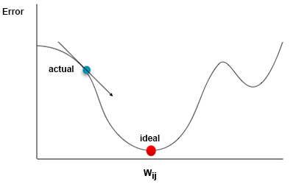
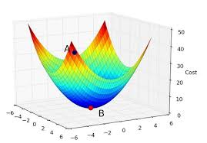
Gradient Descent algorithm
Gradient descent is a first-order iterative optimization algorithm for finding the minimum of a function. Gradient descent is also known as Steepest Descent.
The gradient is a multi-variable generalization of the derivative. While a derivative can be defined on functions of a single variable, for functions of several variables, the gradient takes its place. The gradient is a vector-valued function, as opposed to a derivative, which is scalar-valued.
The gradient represents the slope of the tangent of the graph of the function. More precisely, the gradient points in the direction of the greatest rate of increase of the function. To find a local minimum of a function using gradient descent, one takes steps proportional to the negative of the gradient (or approximate gradient) of the function at the current point.
If, instead, one takes steps proportional to the positive of the gradient, one approaches a local maximum of that function; the procedure is then known as Gradient Ascent.
Gadient descent (ascent) may overlap with Hillclimbing but a principle difference is
that the pure gradient approaches strictly prefers gradient steepness while hill climbing
always selects the most promising next state. Also hillclimbing can handle discrete states. Both approaches are Greedy.
..

Slide 8
Mean Squared Error (MSE)
.
Mean Squared Error (MSE) is an error estimate that measures the average of the squared differences between a series of estimated values and what is estimated.
If y1, y2,....yn represent a sequence of estimates of an target variable Y
then the Mean square error (MSE) = Sum ( (Y-yi )^2) /n.
i=1..n
If the MSE error estimate is applied in the context of an ANN we can look either at
A single data-item run:
error E = ( (T– Y) ^2) /2 - the derivative of E -> T-Y
An Epoque = The ANN runs for all dataitems in the dataset, assume the number is N.
error E = Sum ((Yi – Y)^2) /N/2 - the derivate is Sum(Ti-Yi) /N
i=1..N. i=1..N.
where the number: / 2 is choosen for convenience to simplify derivations.

Slide 9
Mathematical Fundamentals for ANN study
Vector and Matrix fundamentals
Elementary Matrices
Vectors
Linearity
Inner and Outer Products
Measures of Similarity in Vector Space
Differentiation of matrices and Vectors
The Chain Rule
Multidimensional Taylor Series Expansions
The Pseudoinverse of a matrix and Least Squares Techniques
Eigenvalues and Eigenvectors
Geometry for state-space visualization
Geometric interpretation of ANN mappings
Hypercubes
ANN mappings, Decision regions & boundaries, Discriminant functions
Quadratic surfaces and boundaries
Optimizaton
Gradient Descent-based procedures
Error functions contours and trajectories
Graphs and Digraphs

Slide 10
Structure of Lectures in week 6
We are here
L1 Fundamentals of
Neural Networks
McCulloch and Pitts
Supervised learning L2 Perceptrons Linear L6 Hebbian Learning and
- classification classification Associative Memory
- regression
L3 och L4 Feed forward multiple layer Reinforcement
networks and Backpropagation learning Unsupervised learning
L5 Recurrent Neural Sequence and L7 Hopfield Networks and
Perception Networks (RNN) temporal data Boltzman Machines
L8 Convolutional Neural
Networks (CNN)
L9 Deep Learning and
recent developments
Development of
the ANN field
L10 Tutorial on assignments

Slide 11
Deep Learning (1986....2000....2012....2018.....)
1986 Rina Dechter introduced the term Deep Learning, but not primarily in the context of ANNs.
The term could easily have been used for the work by Rumelhart and Hinton that revived
the ANN field but it was NOT.
2000 The term Deep Learning was first used in the ANN context by Igor Aizenberg and colleagues.
2012 The use of term took off after theAlexnet breakthrough in the Imagenet challenge by Geoffrey Hinton Alex Krizhevsky and Ilya Sutskever.
Dominates as a term referering to work on ANN in Machine Learning.
.............
Is Deep Learning just the term for state of the art work in ANN or is it something more specific?

Slide 12
NPTEL
Video Course on Machine Learning
Professor Carl Gustaf Jansson, KTH
Thanks for your attention!
The next lecture 6.2 will be on the topic:
Perceptrons

